Slide 1
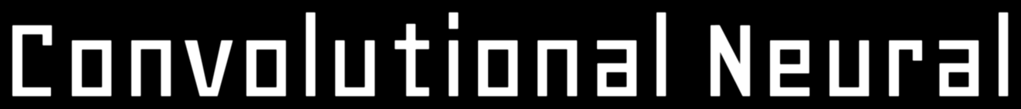
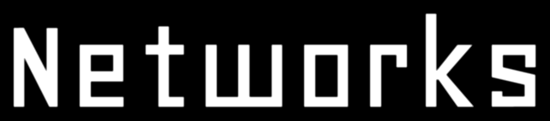

Slide 2
What are Convolutional Neural Networks?
A Convolutional Neural Network is a Deep Learning algorithm that can take in an input image, assign importance (learnable weights and biases) to various aspects/objects in the image, and be able to differentiate one from the other
CNN uses convolution operation to process the data that differentiates it from other neural networks

Slide 3
Why CNN?
In a regular neural network, each neuron in a given layer is fully connected to all the neurons in the previous layers
Due to a large number of connections and number of parameters to be learned, the complexity of such a model becomes too high for tasks like image processing where the number of input features would be of large dimension
Moreover, in the input image, most of the pixel portions may not contribute to predicting the output

Slide 4
By performing such convolution operations, the dimensionality of the input image decreases significantly, and hence, the number of parameters needed to be learned also decreases
To overcome these challenges, the concept of CNN was discovered, where the input image data is subjected to a set of convolution operations

Slide 5

In this image of a dog, we can observe that there are only some pixels that contribute to predicting the output; the background features are not of much importance

Slide 6
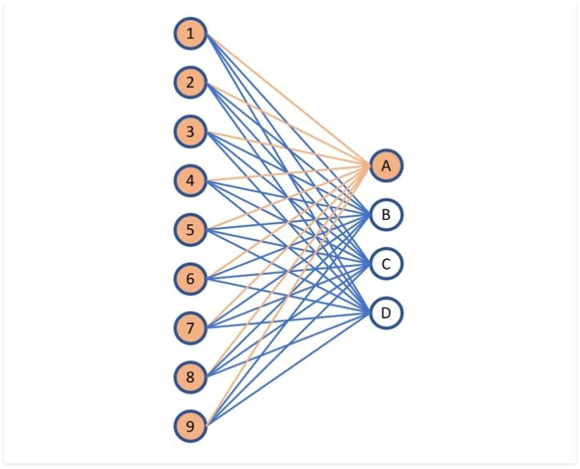
Fully Connected Layer
A fully connected layer is a neural network in which each neuron applies a linear transformation to the input vector through a weights matrix. As a result, all possible connections layer-to-layer are present, meaning every input of the input vector influences every output of the output vector
All possible connections layer-to-layer are present, meaning every input of the input vector influences the output of the output vector. However, not all weights affect all outputs. The orange lines in the image represent the layer’s first neuron (or perceptron). The weights of this neuron only affect output A and do not have an effect on outputs B, C, or D
Fully Connected Layer

Slide 7
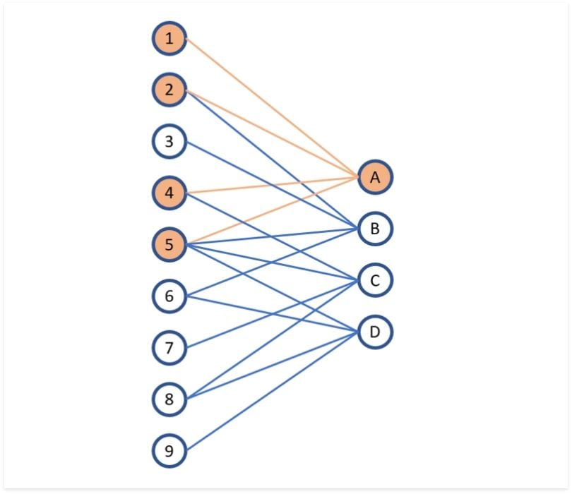
Convolutional Layer
A convolutional layer applies to a neural network in which not all input nodes in a neuron are connected to the output nodes. This gives convolutional layers more flexibility in learning. The number of weights per layer is also a lot smaller, which helps in high-dimensional inputs, such as image data
These advantages give CNNs their well-known characteristic of learning features, such as shapes and textures in image data.
Convolutional Layer

Slide 8
What is a filter?
A filter/kernel here is a matrix that measures how close a patch or a region of the input resembles a feature (any prominent aspect of the image – which may be a vertical edge, horizontal edge, an arch, a diagonal, etc.)
There are many types of filters suited for extracting different kinds of features from the input image
Some common filters are:
Gaussian Blur Filter
Edge Detection Filter
Sobel Filter
Canny Edge Filter

Slide 9
Well, these are just some of the basic filters; the deeper we go into the network, the more sophisticated the filters will get
In later layers, instead of edges and corners, our filters may be able to detect specific objects such as eyes, ears, hair, beak, wings, etc.
In even deeper layers, more complex objects such as a full human, cat, or dog could be identified

Slide 10
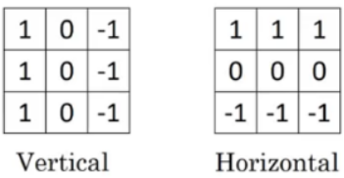
Vertical edge and Horizontal edge filters

Slide 11
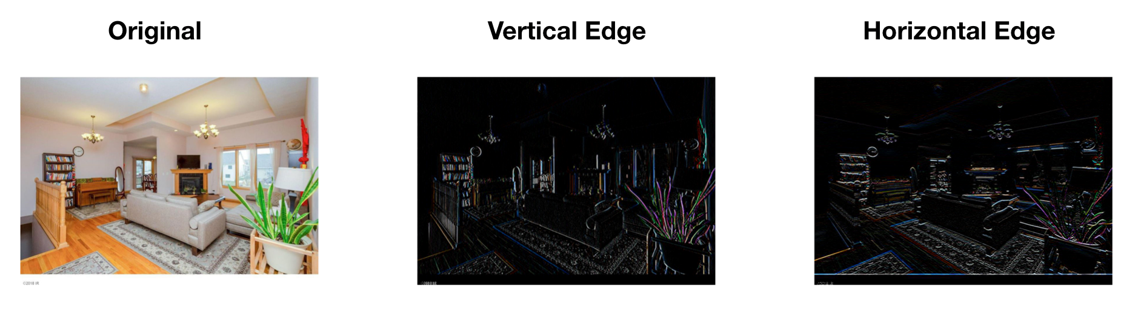
How an image looks after passing it through a vertical edge filter and a horizontal edge filter

Slide 12
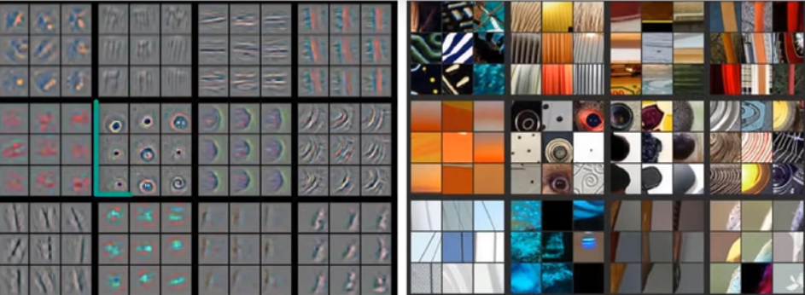
Examples of more complex filters that may appear when we go deeper into the network

Slide 13
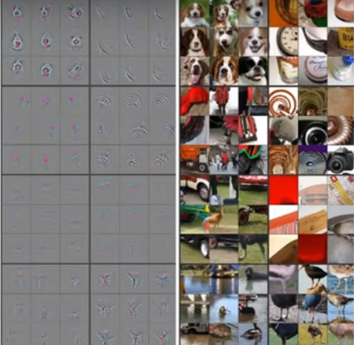
Filters that detect dogs, birds, etc.

Slide 14
How does Convolution work?
Mathematically, convolution is the summation of the element-wise product of 2 matrices
In CNN, the image input and a filter are the 2 ‘matrices’ that are convolved with each other to produce an output matrix
The kernel is overlapped with the image matrix, and the overlapping indices are multiplied and added, to replace the value of the central element
[(n x n) image] * [(f x f) filter] —> [(n – f + 1) x (n – f + 1) image]

Slide 15
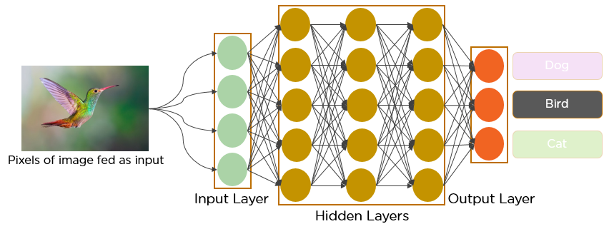
A Convolutional Neural Network that recognizes a bird

Slide 16
The Convolution Operation

Slide 17
Convolution Operation Demonstration:
https://deeplizard.com/resource/pavq7noze2

Slide 18
Convolutions on RGB image
A grayscale image can be represented using just one band where the value of each pixel can vary from 0-255
We know that Red, Green, and Blue are the 3 fundamental colours which means that different colours can be represented by combining different proportions of red, green, and blue

Slide 19
A colour image, on the other hand, needs to be represented with three bands or channels – Red, Green, and Blue (each pixel of the image will have some values of R, G, and B)
Here, the kernel also will have three channels for each of the three channels of the input image

Slide 20
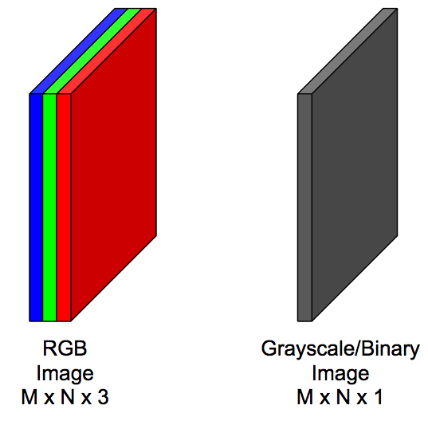

Slide 21
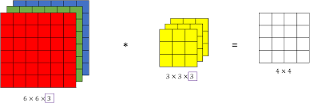
A 3-channel RGB image convoluted with a 3-channel 3x3 filter

Slide 22
Padding
While performing the convolution operation by super-imposing the filter all around the input image, the pixels in the corners are used much less than the ones in the centre – which means the information on the borders is not preserved as well as the information in the middle
To avoid this problem, we add layers of zeroes to our input image, and this process is known as padding
This prevents over-shrinking of the image as the size of the output image would now be (n + 2p – f + 1) x (n + 2p – f + 1) instead of (n – f + 1) x (n – f + 1)
Input image with Zero Padding convoluted with a 3x3 filter

Slide 23
Stride
Stride is a parameter of the neural network’s filter that modifies the amount of movement over the input image, if the stride is set to 1, the filter will move one pixel at a time. Naturally, as the stride is increased, the resulting output will be smaller
Stride works in conjunction with padding to decrease the size of the image to counteract the fact that padding increases the size
In this example, the stride is 2
Input image with Zero Padding convoluted with 3x3 filter with Stride = 2

Slide 24
Pooling
Pooling operation involves sliding a 2-dimensional filter over each channel of the feature map and summarising the features lying within the region covered by the filter
Pooling layers are used to reduce the dimensions of the feature maps. Thus, it reduces the number of parameters to learn and the amount of computation performed in the network
The pooling layer summarizes the features present in a region of the feature map generated by a convolution layer. So, further operations are performed on summarized features instead of precisely positioned features generated by the convolution layer

Slide 25
Types of Pooling
Max Pooling: selects the maximum element from the region of the feature map covered by the filter. Thus, the output after the max-pooling layer would be a feature map containing the most prominent features of the previous feature map
Average Pooling: computes the average of the elements present in the region of the feature map covered by the filter. Thus, while max pooling gives the most prominent feature in a particular patch of the feature map, average pooling gives the average of features present in a patch

Slide 26
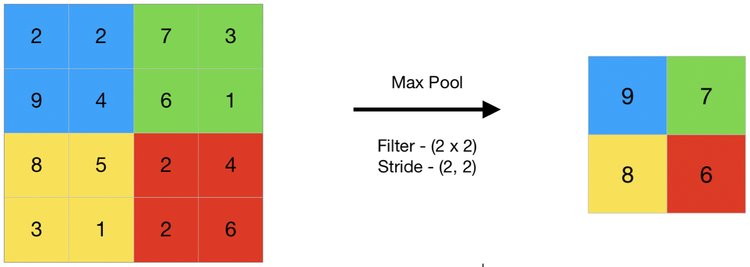
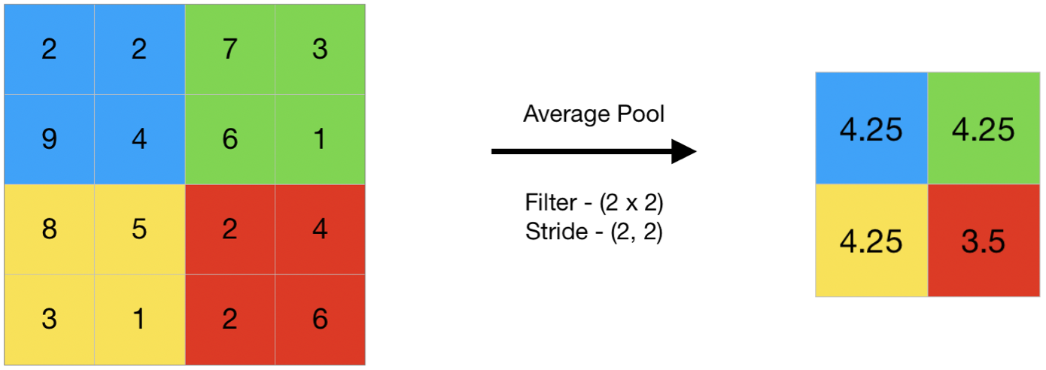
Max Pooling
Average Pooling

Slide 27
Max Pooling Demonstration:
https://deeplizard.com/resource/pavq7noze3

Slide 28
CNN Architecture

Slide 29

Until now, we have been introduced to various components of a Convolutional Neural Network
A Convolutional Neural Network consists of two main parts:
Feature Extraction
Classification

Slide 30
There are three types of layers that make up the CNN which are the convolutional layers, pooling layers, and fully-connected layers, and it uses a backpropagation algorithm to learn spatial hierarchies of data automatically and adaptively. In addition to these three layers, there are two more important parameters which are the dropout layer and the activation function
Convolution layer – separates and identifies the various features of the image for analysis
Pooling layer – Pooling layers are used to reduce the dimensions of the feature maps
Fully Connected Layer – utilizes the output from the convolution process and predicts the class of image based on the features extracted in previous stages

Slide 31
What is Overfitting?
Overfitting occurs when our model becomes really good at being able to classify or predict data that was included in the training set but is not so good at classifying data that it wasn’t trained on, so essentially, the model has overfit the data in the training set
This concept boils down to the fact that the model is unable to generalize well (it has learned the features of the training set extremely well but if we give the model any data that slightly deviates from the exact data used during training, it is unable to generalize and accurately predict the output

Slide 32
We can tell if our model is overfit based on metrics that are given for our training and validation data during the training process
If the validation metrics are considerably worse than the training metrics, it is an indication that our model is overfit

Slide 33
Dropout Layer
Usually, when all the features are connected to the FC layer, it can cause overfitting in the training dataset
Overfitting occurs when a particular model works so well on the training data causing a negative impact on the model’s performance when used on new data
To overcome this problem, a dropout layer is utilized wherein a few neurons are dropped from the neural network during the training process resulting in reduced size of the model

Slide 34
In this example, we are passing a dropout of 0.5, which means 50% of the nodes are dropped out randomly from the neural network

Slide 35
Activation Function
They are used to learn and approximate any continuous and complex relationship between the variables of the network
It decides which information of the model should fire in the forward direction and which ones should not at the end of the network
In simple terms, activation function determines whether a neuron must be activated or not, it decides whether the input to the work is important or not to predict using mathematical operations

Slide 36
How does the Network learn?
What exactly does it mean for a model to learn?
It should be able to give an accurate output for a variety of possible inputs
We know that forward propagation is the propagation of data in the forward direction through the network until it reaches the output layer. This output is a weighted sum of the weights at each of these connections multiplied by the previous layer’s output. We then pass the weighted sum to an Activation function whose result is the output for a particular node which is passed as part of the input for the nodes in the next layer

Slide 37
We then calculate the loss function, which tells us how far off the model is on classifying the given input
Therefore, to make the network learn, we must make sure that we are progressively reducing this loss and trying to get closer to our desired output
This is where Optimizing Algorithms and Backpropagation fit in

Slide 38
Backpropagation in CNN
Our goal now is to minimize the loss that we calculate after the data reaches the output layer
For the loss function to be minimum, the output node corresponding to the input should have a much higher value than the other output nodes
The value of any output node depends on the following:
weights
outputs of the previous layer

Slide 39
We cannot directly change the activation output of a particular layer as it is a calculation based on the weights and the previous layer’s output
But we can indirectly influence a change in this layer’s activation by jumping backward and updating the weights there
This process of updating the weights of a layer to influence the activation output of the next layer is done with the help of an optimizing algorithm
How the weights or learning rates of the neural network are to be changed to reduce the losses, is defined by the optimizing algorithm we use

Slide 40
SGB (Stochastic Gradient Descent) is one of the most popular such algorithms in which we find the gradient of the loss function with respect to the weight and multiply it with a parameter called ‘learning rate’ and replace the weight with this value
We continue updating the weights of the previous layer continues till we reach the input layer
This whole process of updating the weights using an optimizing algorithm is Backpropagation

Slide 41
Forward and Backward Propagation

Slide 42
Epoch and Batch Size
One epoch is when the entire dataset is passed forward and backward through the neural network once
Definitely, for training our network for accurate predictions, one epoch will not be enough; we will have to feed the network the training data for more than one epoch in different patterns, for a better generalization when given new unseen input
Batch size is the number of samples that will be passed through to the network at one time
Batches in epoch = Training set size / Batch size

Slide 43
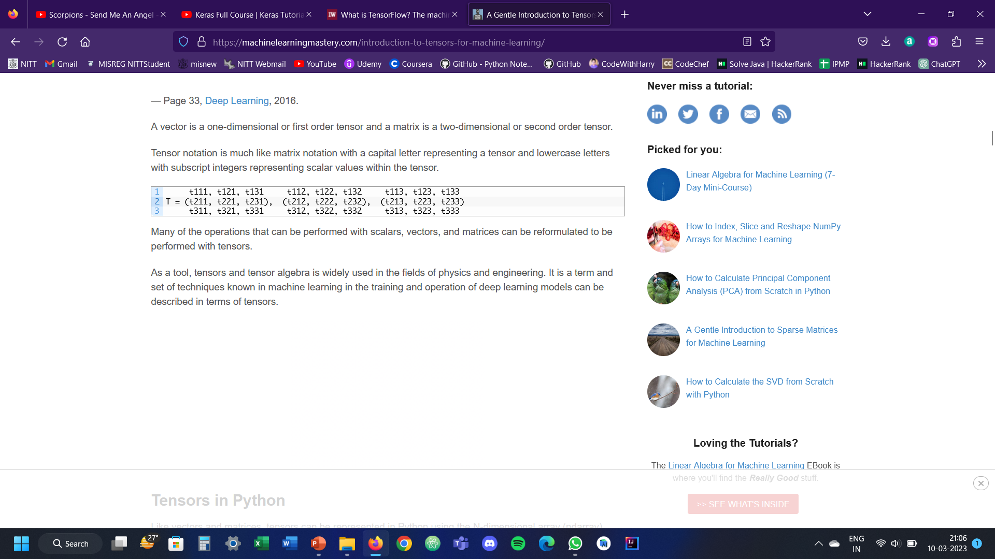
What is a Tensor?
In the general case, an array of numbers arranged on a regular grid with a variable number of axes is known as a tensor
A vector is a one-dimensional or first-order tensor and a matrix is a two-dimensional or second-order tensor
Tensor notation:

Slide 44
There are 3 primary parameters we use to define a tensor:
Rank – the total number of dimensions in a tensor is referred to as the rank of a tensor
Shape – the number of elements that exist in each dimension of the tensor. The total number of elements in a tensor is the product of the sizes of all its shapes; for example, if the tensor shape is [2, 2], the number of elements is 4
Data Type – refers to the type of data contained in it

Slide 45
Keras
Keras is a deep learning API written in python and running on top of TensorFlow
We use Keras if we need a deep-learning library that:
Allows easy, fast prototyping
Supports both convolutional networks and recurrent networks, as well as a combination of the two
Runs seamlessly on CPU and GPU
It allows us to avoid having to build neural networks from scratch
It hides a lot of mathematical complexity (that, otherwise, we would have to implement) inside of helpful packages, modules, and methods

Slide 46
Conv2D (2D Convolution Layer)
This layer creates a convolution kernel that is convolved with the layer input to produce a tensor of outputs
If the argument activation is not None, it is applied to the outputs as well
When using this layer as the first layer in a model, provide the keyword argument input_shape (tuple of integers or None, does not include the sample axis)
The arguments taken by the function Conv2D are

Slide 47
Filters – Integer, the dimensionality of the output space (i.e., the number of output filters in the convolution)
Kernel_size – an integer or tuple/list of 2 integers, specifying the height and width of the 2D convolution window (cannot be a single integer to specify the same value for all spatial dimensions)
Padding – can be either ‘valid’ or ‘same’. Valid means no padding. Same results in padding with zeroes evenly to the left/right or up/down of the input

Slide 48
Kernel_initializer – initializer for the kernel weights matrix
Activation – specifies the activation function to use
Input_shape – it will be the shape of the input tensor we provide

Slide 49
MaxPooling2D (Max Pooling Layer)
Max Pooling of 2D spatial data
Downsamples the input along its spatial dimensions (height and width) by taking the maximum value over an input window for each input channel. The window is shifted by strides along each dimension
The resulting output, when using the ‘valid’ padding option, has a spatial shape of:
output_shape = math.floor((input_shape - pool_size) / strides) + 1 (when input_shape >= pool_size)
The resulting output shape when using the ‘same’ padding option is:
output_shape = math.floor((input_shape - 1) / strides) + 1

Slide 50
Arguments taken by MaxPooling2D:
Pool_size – integer or tuple of 2 integers, window size over which we take the maximum value
Strides – integer, tuple of 2 integers, or None. Specifies how far the pooling window moves for each pooling step
Padding – either ‘valid’ or ‘same’

Slide 51
Dropout Layer
We have already discussed what the dropout layer is and why we use it in our network; here, we are going to look into the arguments taken by the dropout layer function in Keras:
Rate: float between 0 and 1, specifies the fraction of input units to drop
Noise_shape: 1D integer tensor representing the shape of the binary dropout mask that will be multiplied with the input. For instance, if our inputs have shape (batch_size, timesteps, features) and we want the dropout mask to be the same for all timesteps, we can use noise_shape = (batch_size, 1, features)

Slide 52
